Slide 1

NODE JS
Aruna S
Department of
Computer Science and Engineering

Slide 2

NODE JS
HTTP Module
S. Aruna
Department of Computer Science and Engineering

Slide 3
NODE JS
Web Server
A Web Server is a software application which handles HTTP requests sent by the HTTP client, like web browsers, and returns web pages in response to the clients.
Web servers usually deliver html documents along with images, style sheets, and scripts.
Most of the web servers support server-side scripts, using scripting languages or redirecting the task to an application server which retrieves data from a database and performs complex logic and then sends a result to the HTTP client through the Web server.
Apache web server is one of the most commonly used web servers. It is an open source project.

Slide 4
NODE JS
Web Application Architecture
A Web application is usually divided into four layers −
Client − This layer consists of web browsers, mobile browsers or applications which can make HTTP requests to the web server.
Server − This layer has the Web server which can intercept the requests made by the clients and pass them the response.
Business − This layer contains the application server which is utilized by the web server to do the required processing. This layer interacts with the data layer via the database or some external programs.
Data − This layer contains the databases or any other source of data.

Slide 5
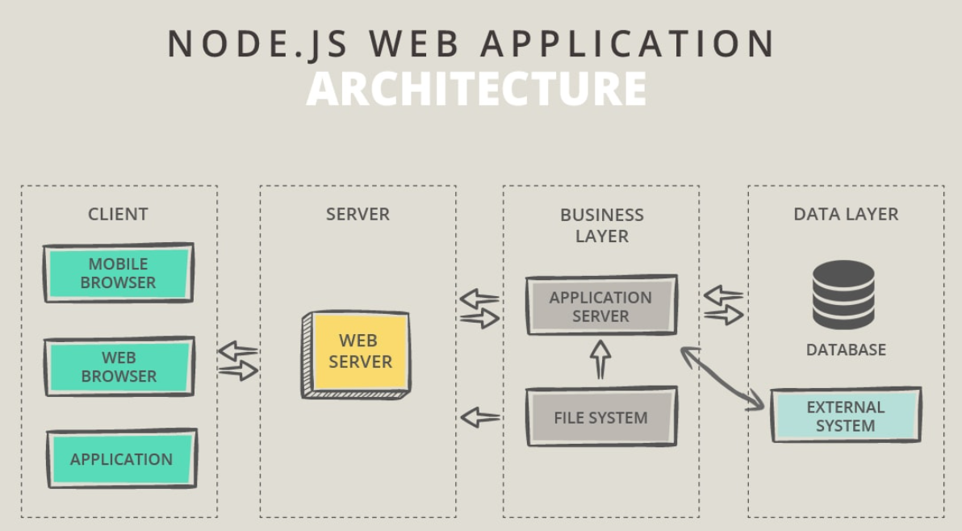
NODE JS
Web Application Architecture

Slide 6
NODE JS
HTTP Module – Properties and Methods
The module provides some properties as below.
http.METHODS
This property lists all the HTTP methods supported
http.STATUS_CODES
This property lists all the HTTP status codes and their description
http.globalAgent
Points to the global instance of the Agent object, which is an instance of the http.Agent class.It's used to manage connections persistence and reuse for HTTP clients, and it's a key component of Node.js HTTP networking.

Slide 7
NODE JS
HTTP Module – Properties and Methods
The module provides some methods as below
http.createServer()
Return a new instance of the http.Server class.
http.request()
Makes an HTTP request to a server, creating an instance of the http.ClientRequest class.
http.get()
Similar to http.request(), but automatically sets the HTTP method to GET, and calls req.end() automatically.

Slide 8
NODE JS
HTTP Module – Classes
The HTTP module provides 5 classes:
http.Agent - This object makes sure that every request made to a server is queued and a single socket is reused.
http.ClientRequest - An http.ClientRequest object is created when http.request() or http.get() is called.
http.Server- This class is commonly instantiated and returned when creating a new server using http.createServer().
Once you have a server object, you have access to its methods:
close() stops the server from accepting new connections
listen() starts the HTTP server and listens for connections

Slide 9
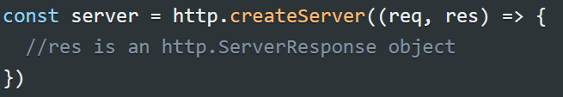
NODE JS
HTTP Module – Classes
http.ServerResponse-Created by an http.Server and passed as the second parameter to the request event it fires.
Commonly known and used in code as res:
http.IncomingMessage - An http.IncomingMessage object is created by:
http.Server when listening to the request event
http.ClientRequest when listening to the response event
The data is accessed using streams, since http.IncomingMessage implements the Readable Stream interface.

Slide 10

NODE JS
HTTP Module – Web Server using Node
The components of a Node.js application.
Import required modules − We use the require directive to load Node.js modules.
Create server − A server which will listen to client's requests similar to Apache HTTP Server. Node.js has a built-in module called HTTP, which allows Node.js to transfer data over the Hyper Text Transfer Protocol (HTTP).
Read request and return response − The server created in an earlier step will read the HTTP request made by the client which can be a browser or a console and return the response.
Creating Node.js Application
Step 1 - Import Required Module
We use the require directive to load the http module and store the returned HTTP instance into an http variable as follows

Slide 11
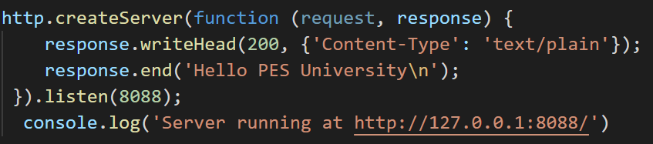
NODE JS
HTTP Module
Step 2 - Create Server
We use the created http instance and call http.createServer() method to create a server instance.
Then we bind it at port 8088 using the listen method associated with the server instance.
Step 3 - Testing Request & Response
$node app.js
Verify the Output. Server has started.
Server running at http://127.0.0.1:8088/

Slide 12

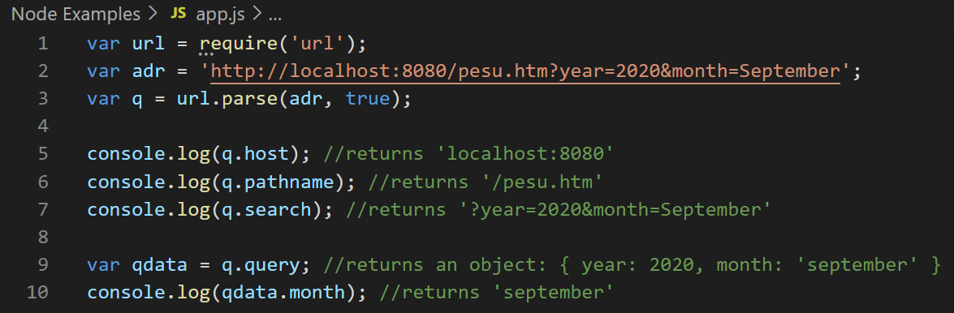
NODE JS
URL Module
The URL module splits up a web address into readable parts.
To include the URL module, use the require() method:
Parse an address with the url.parse() method, and it will return a URL object with each part of the address as properties:

Slide 13
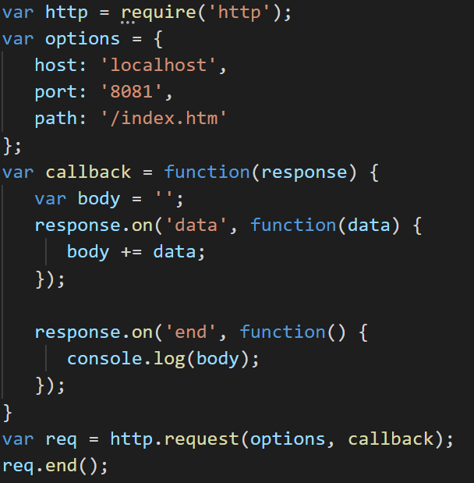
NODE JS
Web Client Using Node
A web client can be created using http module. A Screenshot of the example is below

Slide 14
THANK YOU
Aruna S
Department of
Computer Science and Engineering
arunas@pes.edu

